Slide 1




Fixing Distributed Systems Fail
Jimmy Bogard
@jbogard
github.com/jbogard
jimmybogard.com

Slide 2
6 little, innocuous lines of code

Slide 3
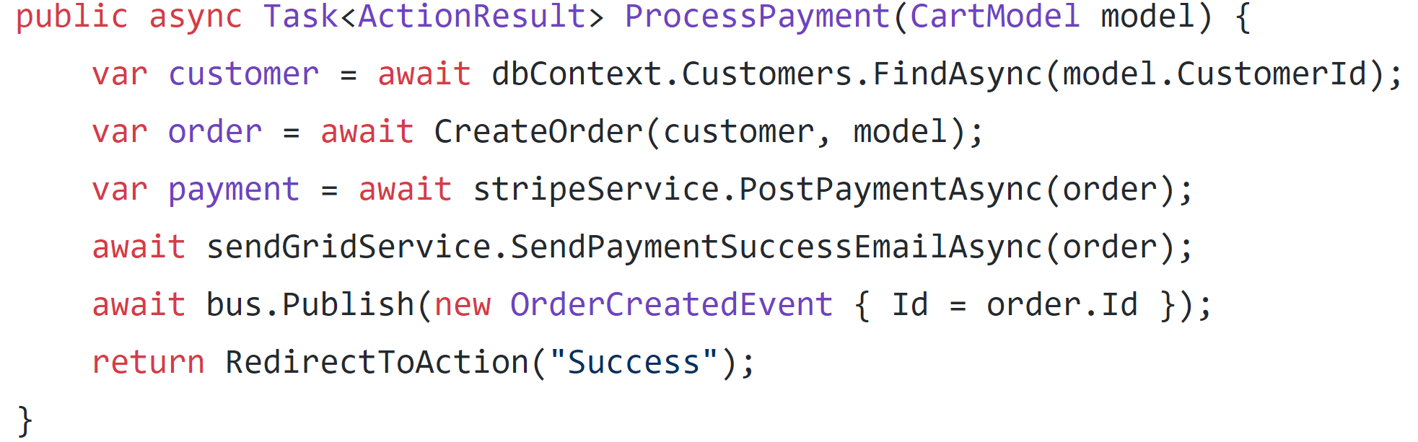

Slide 4
Find Customer from DB

Slide 5
Find Customer from DB
Create Order from cart and customer details

Slide 6
Find Customer from DB
Create Order from cart and customer details
Post payment to Stripe

Slide 7
Find Customer from DB
Create Order from cart and customer details
Post payment to Stripe
Send thank you email via SendGrid

Slide 8
Find Customer from DB
Create Order from cart and customer details
Post payment to Stripe
Send thank you email via SendGrid
Publish a message to RabbitMQ

Slide 9
Find Customer from DB
Create Order from cart and customer details
Post payment to Stripe
Send thank you email via SendGrid
Publish a message to RabbitMQ
Redirect customer to “thank you” page

Slide 10
dbContext.SaveChanges();
Find Customer from DB
Create Order from cart and customer details
Post payment to Stripe
Send thank you email via SendGrid
Publish a message to RabbitMQ
Redirect customer to “thank you” page

Slide 11
Failure is ALWAYS an option

Slide 12
Txn
Stripe
2.
API
POST
3.
1.
SendGrid
DB
4.
RabbitMQ
5.

Slide 13
Txn
Stripe
2.
API
POST
3.
1.
SendGrid
DB
4.
RabbitMQ
5.

Slide 14
Txn
Stripe
2.
API
POST
3.
1.
SendGrid
DB
4.
Transaction rolls back, error shown to user, system is consistent
RabbitMQ
5.

Slide 15
Txn
Stripe
2.
API
POST
3.
1.
SendGrid
DB
4.
RabbitMQ
5.

Slide 16
Txn
Stripe
2.
API
POST
3.
1.
SendGrid
DB
4.
No money posts, transaction rolls back, system is consistent
RabbitMQ
5.

Slide 17
Txn
Stripe
2.
API
POST
3.
1.
SendGrid
DB
4.
RabbitMQ
5.

Slide 18
Txn
Stripe
2.
API
POST
3.
1.
SendGrid
DB
4.
Customer is charged but transaction rolls back, system is inconsistent!
RabbitMQ
5.

Slide 19
Txn
Stripe
2.
API
POST
3.
1.
SendGrid
DB
4.
RabbitMQ
5.

Slide 20
Txn
Stripe
2.
API
POST
3.
1.
SendGrid
DB
4.
Customer is charged and notified but transaction rolls back. System is inconsistent
RabbitMQ
5.

Slide 21
Txn
Stripe
2.
API
POST
3.
1.
SendGrid
DB
4.
RabbitMQ
5.

Slide 22
Txn
Stripe
2.
API
POST
3.
1.
SendGrid
Customer is charged and notified and downstream systems notified but transaction rolls back. System is f@&ked
DB
4.
RabbitMQ
5.

Slide 23
What do?

Slide 24
¯\_(ツ)_/¯ is probably not good for business

Slide 25
Txn
Stripe
2.
API
POST
3.
1.
SendGrid
DB
4.
RabbitMQ
5.

Slide 26
We can’t put the world into a transaction

Slide 27
Assume failures

Slide 28
Plan for the worst

Slide 29
4 options for dealing with failures between two systems
Gregor Hohpe – “Your Coffee Shop Doesn’t Use Two-Phase Commit”
http://bit.ly/2uCevAB

Slide 30
✓
Resource A
Ignore
Action
Resource B

Slide 31
✓
Resource A
Ignore
Action
Resource B
Retry
✓
Resource A
Action
Resource B
(Retry)

Slide 32
✓
Resource A
(Undo)
Resource A
Ignore
Undo
✓
Action
Action
Resource B
Resource B
Retry
✓
Resource A
Action
Resource B
(Retry)

Slide 33
✓
Resource A
(Undo)
Resource A
Ignore
Undo
✓
Action
Action
Resource B
Resource B
Prepare
Retry
✓
Resource A
Coordinate
Resource A
Coordinator
Action
Feedback
Resource B
Resource B
(Retry)
Commit

Slide 34
The Master Plan

Slide 35
For each external resource, examine possibilities and pick best option based on business requirements

Slide 36
First up: Stripe

Slide 38
Option 1: Ignore

Slide 39
Probably don’t want to ignore a failed payment

Slide 40
Option 2: Retry

Slide 43
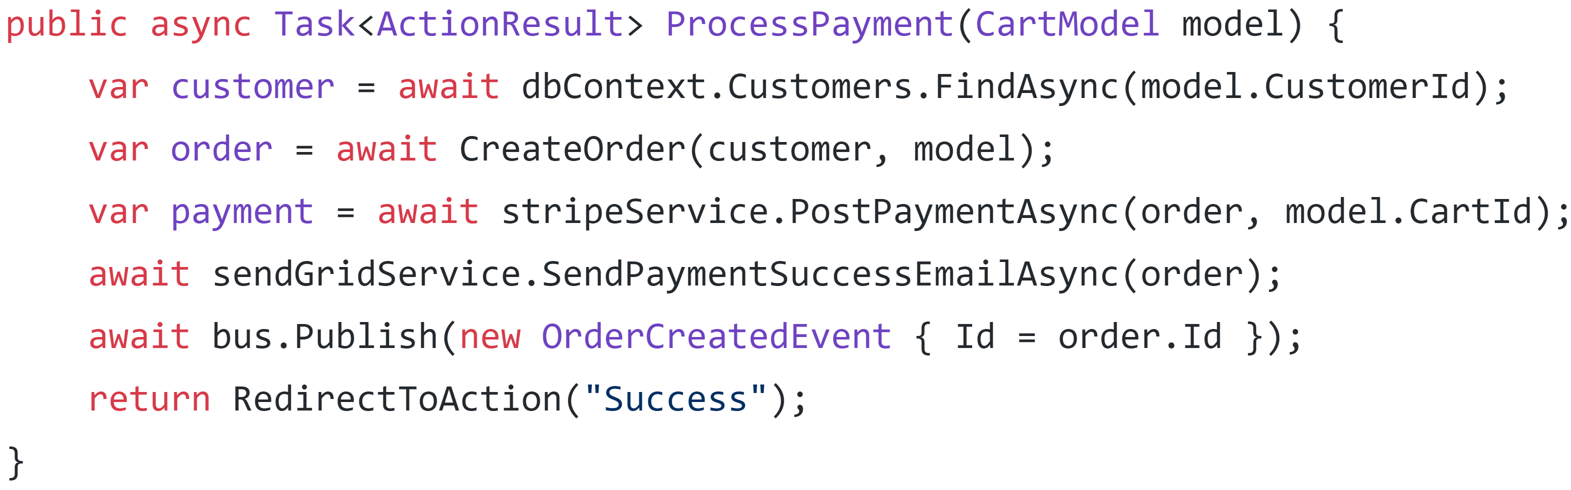

Slide 45
Option 3: Undo

Slide 47
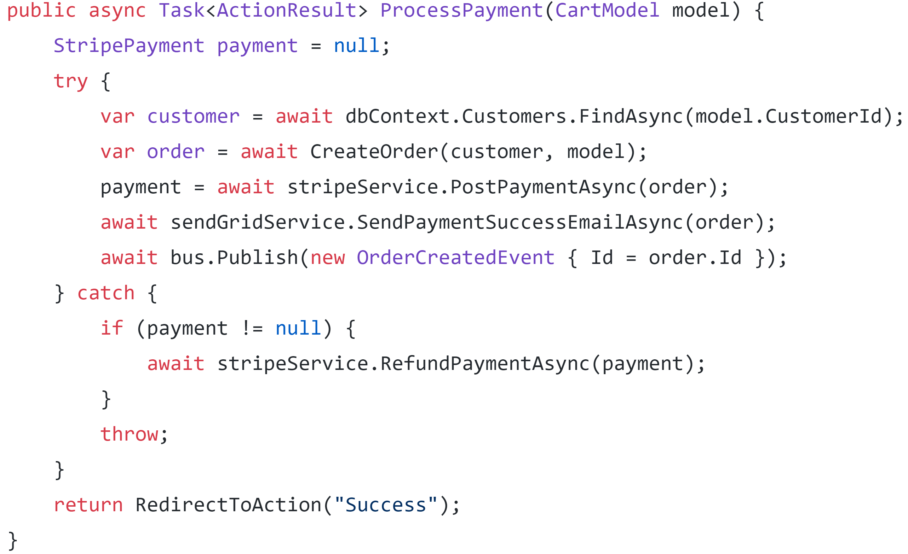

Slide 49
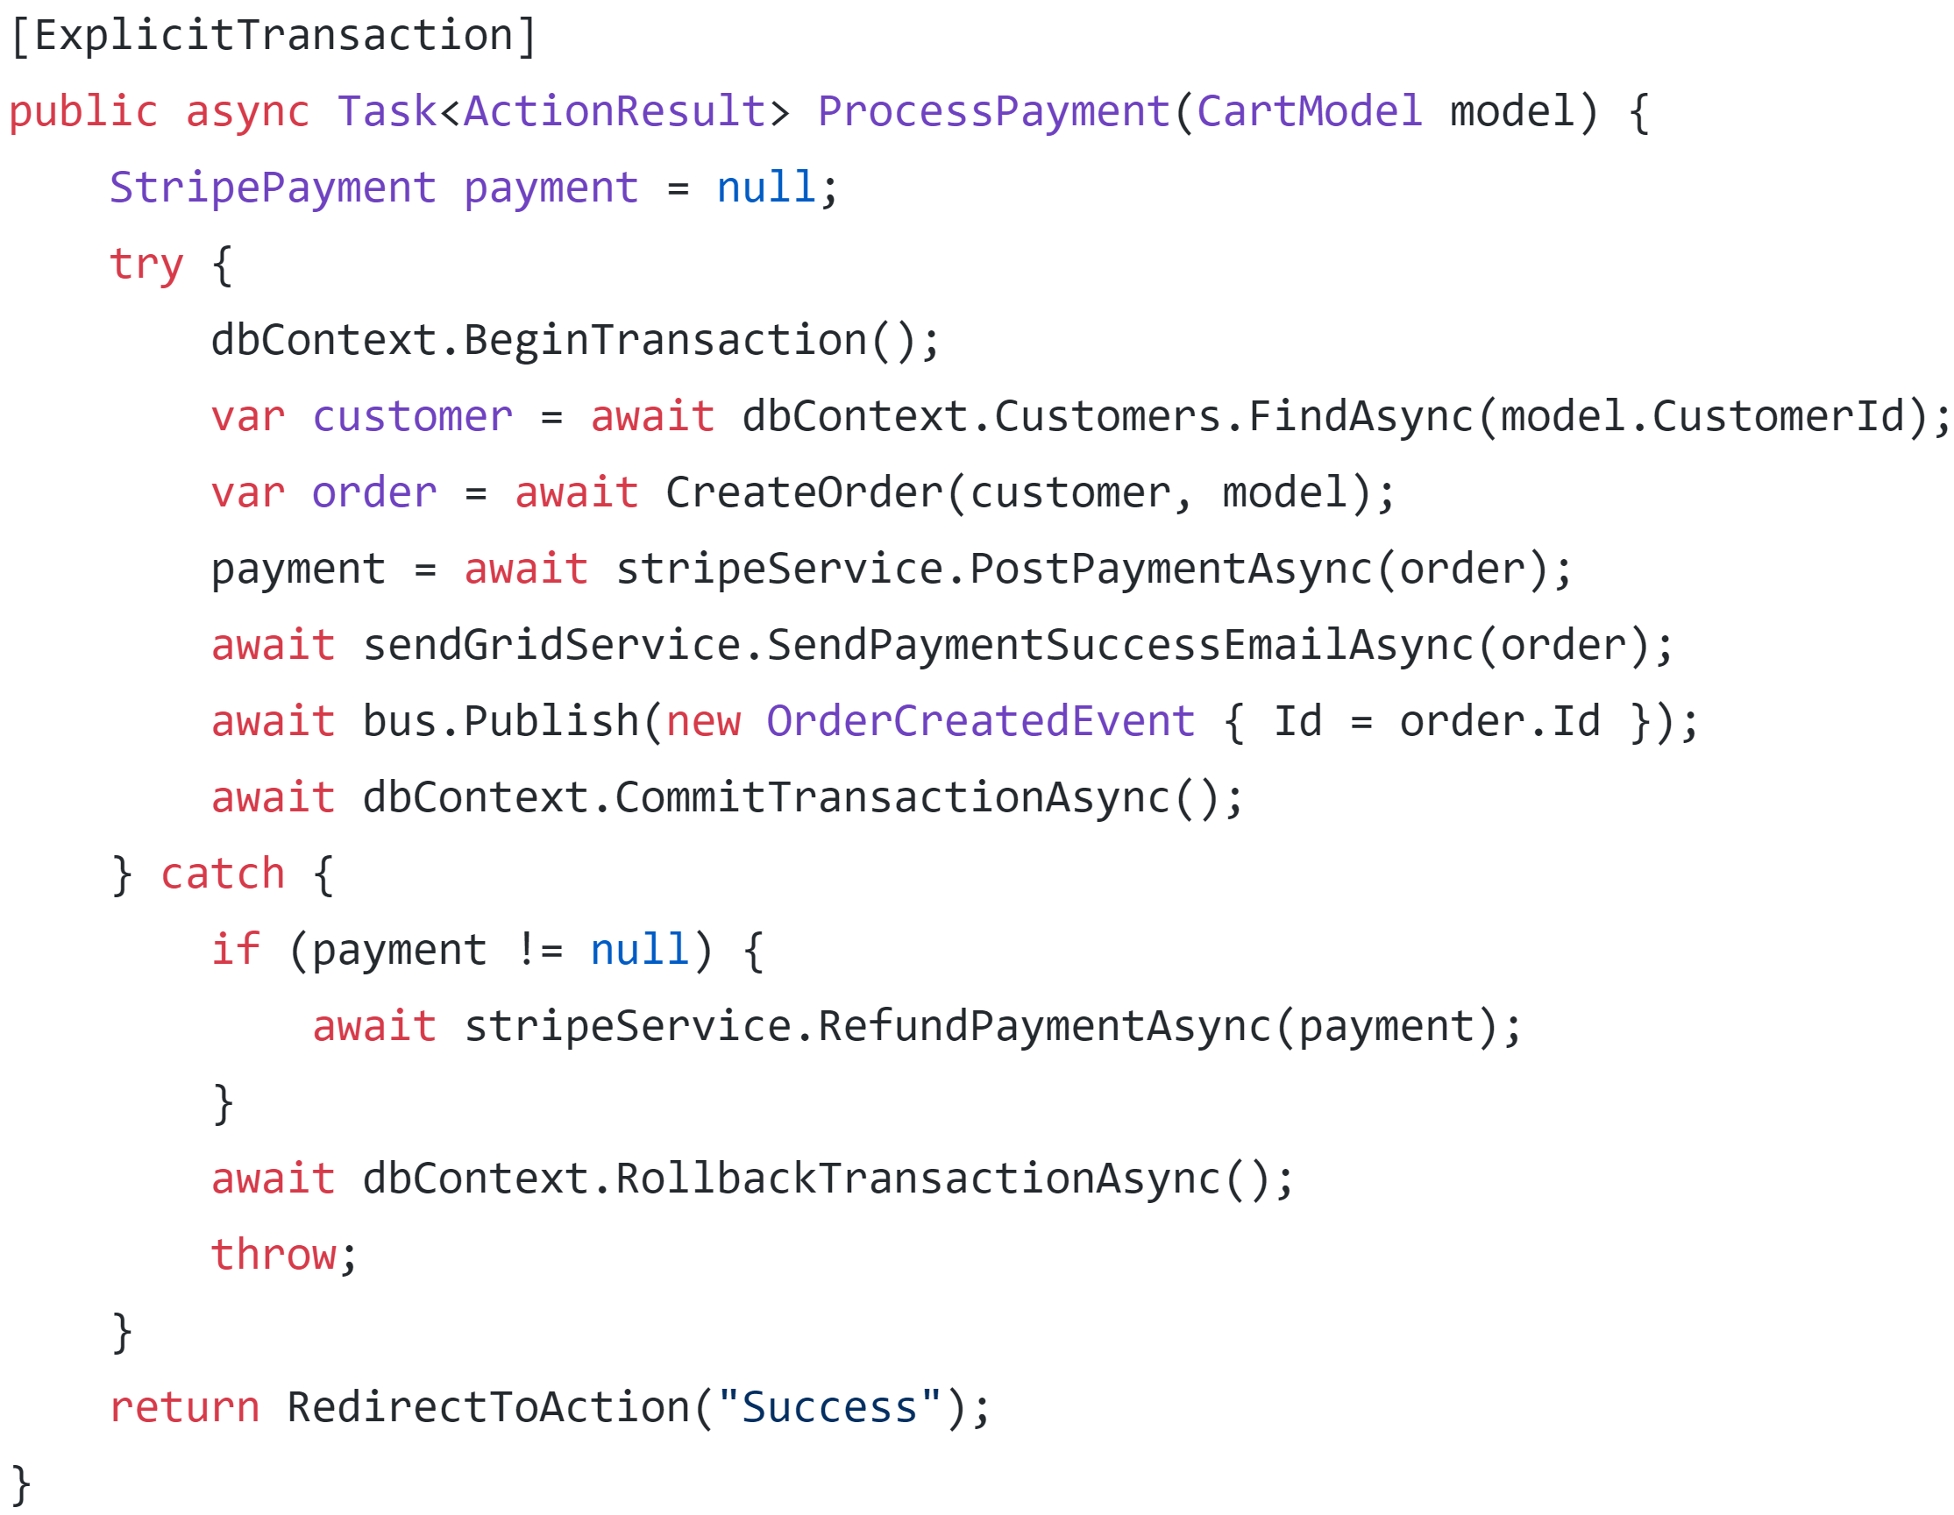

Slide 51
Option 4: Coordinate

Slide 52
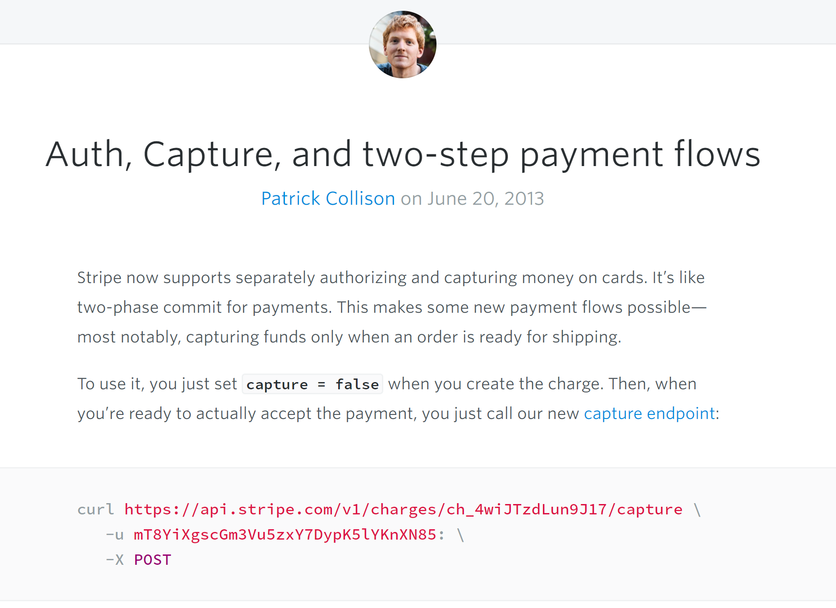

Slide 53
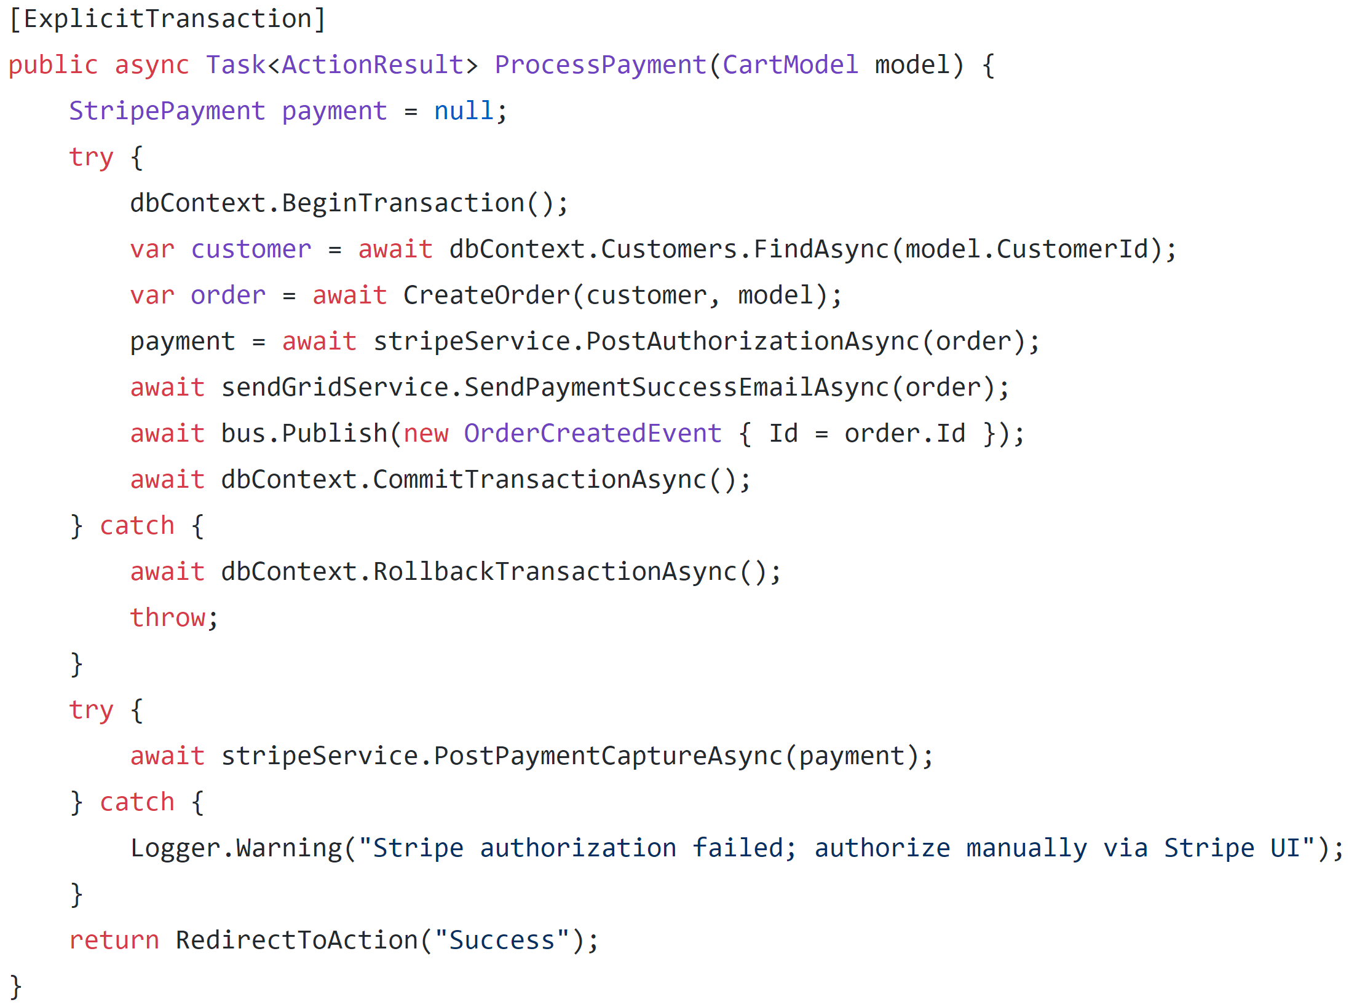

Slide 54
Authorize

Slide 55
Authorize
Capture

Slide 56
Next up: SendGrid

Slide 57
Option 1: Ignore

Slide 58
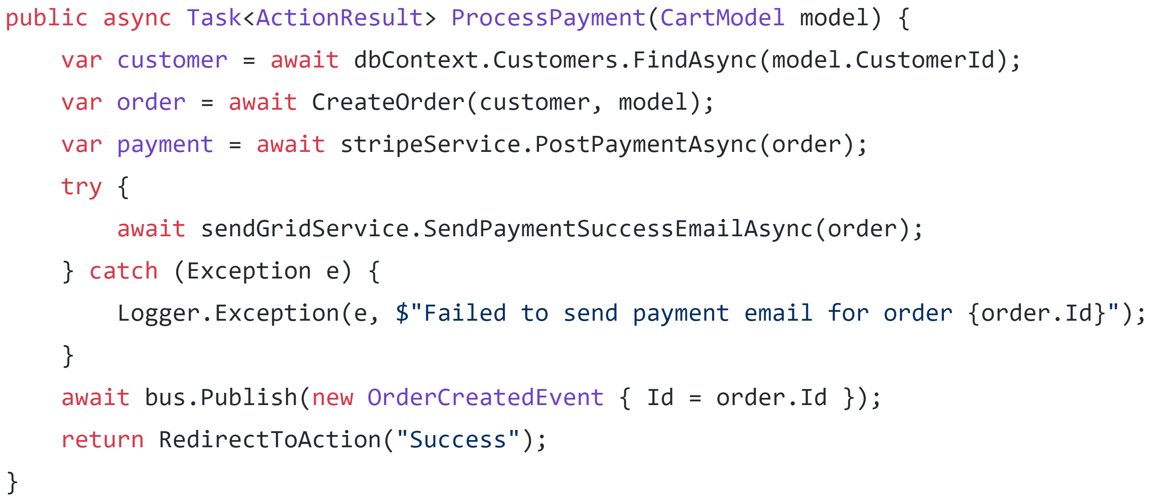

Slide 60
Option 2: Retry

Slide 61
Not unless we want duplicate emails

Slide 62
Option 3: Undo

Slide 63
We can’t un-send emails

Slide 64
Apologize?

Slide 65
Option 4: Coordinate

Slide 66
???????

Slide 67
Finally: RabbitMQ

Slide 68
Option 1: Ignore

Slide 69
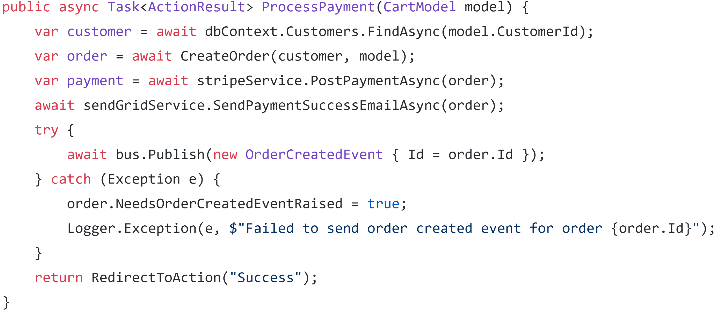

Slide 71
Option 2: Retry

Slide 72
Retry
✓
Resource A
Action
RabbitMQ
(Retry)

Slide 73
Consumer A
Retry
✓
Resource A
Consumer B
Action
RabbitMQ
(Retry)
Consumer C

Slide 74
Option 3: Undo

Slide 75
Can’t un-send a message

Slide 76
Compensating message is...weird

Slide 77
Option 4: Coordinate

Slide 78
 | Ignore | Retry | Undo | Coordinate
Stripe | X | ✓ | ✓ | ✓
SendGrid | ✓ | X | X | X
RabbitMQ | ✓ | X | X | X

Slide 79
Taking a step back

Slide 80
Can we avoid exceptions by breaking the process coupling?

Slide 81
Txn
Stripe
2.
API
POST
3.
1.
SendGrid
DB
4.
RabbitMQ
5.

Slide 82
Txn
Stripe
?
2.
API
POST
3.
1.
SendGrid
DB
4.
RabbitMQ
5.

Slide 83
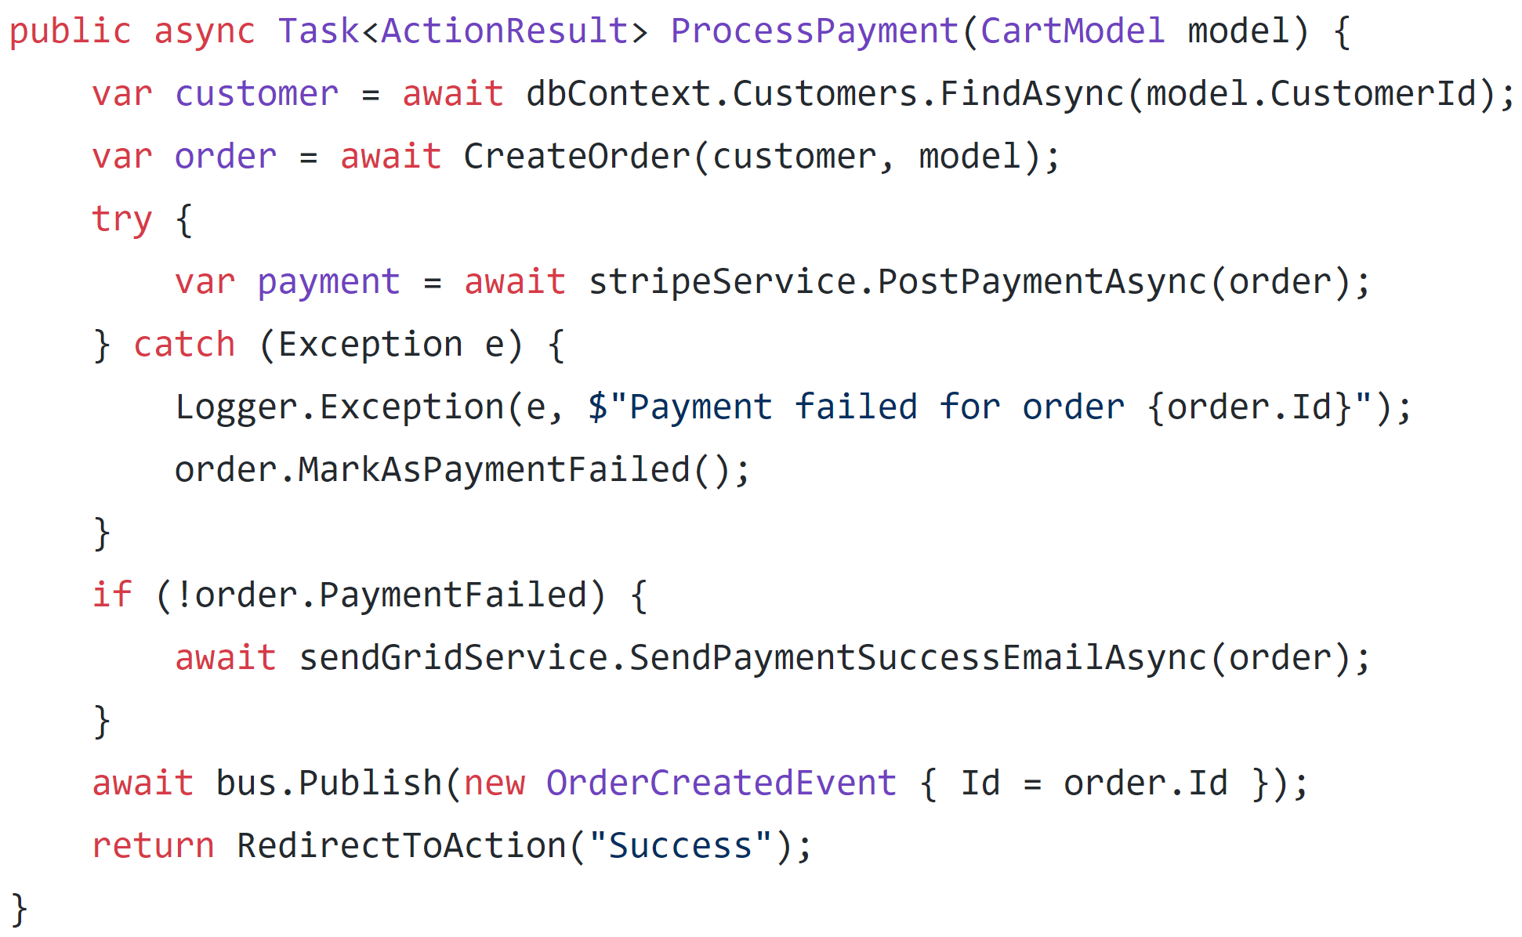

Slide 85
Txn
Stripe
2.
API
POST
3.
1.
SendGrid
?
DB
4.
RabbitMQ
5.

Slide 86
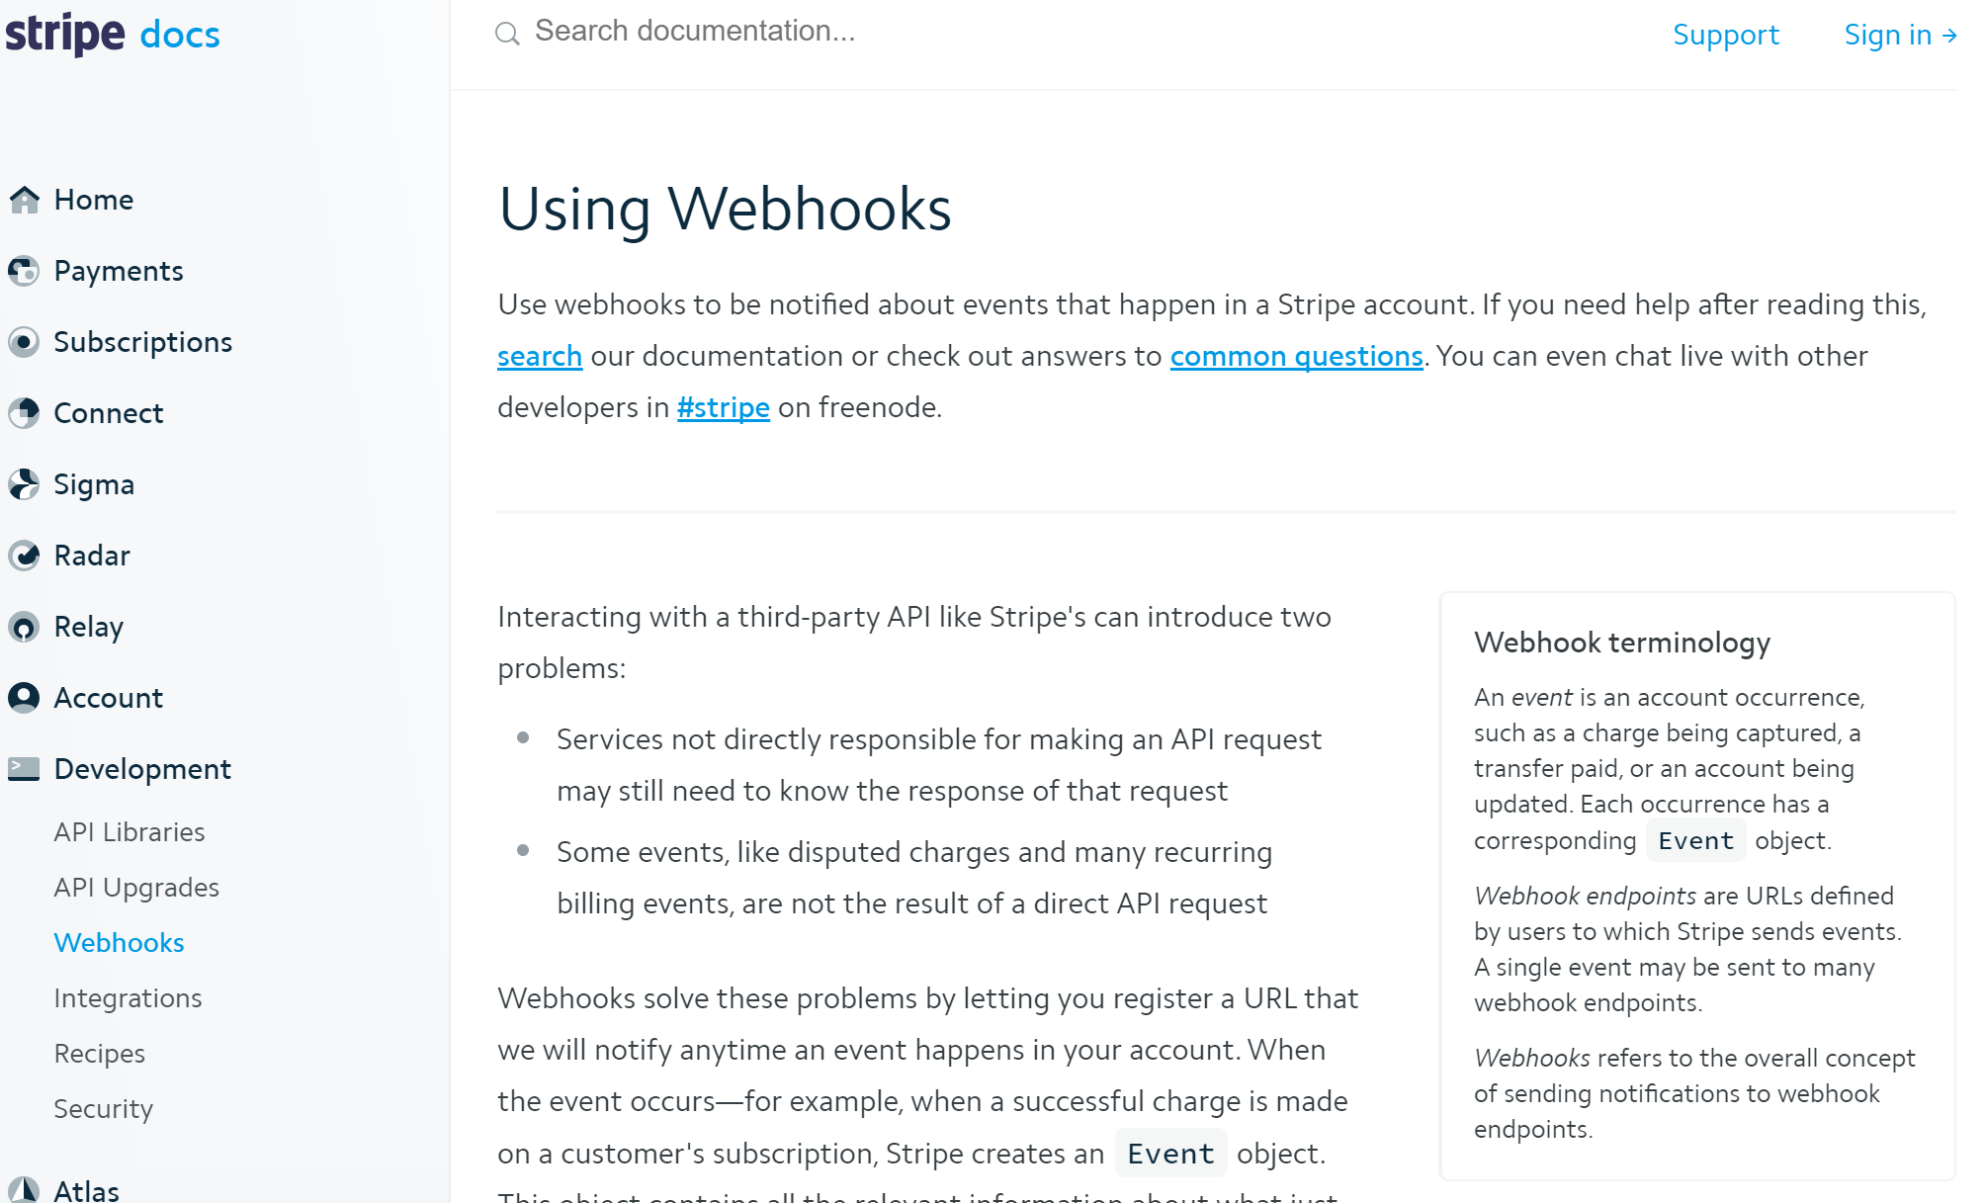

Slide 87
Txn
Stripe
2.
API
POST
3.
1.
SendGrid
DB
4.
RabbitMQ
?
5.

Slide 88
Outbox pattern
Txn
Sender
Broker
Receiver
DB

Slide 89
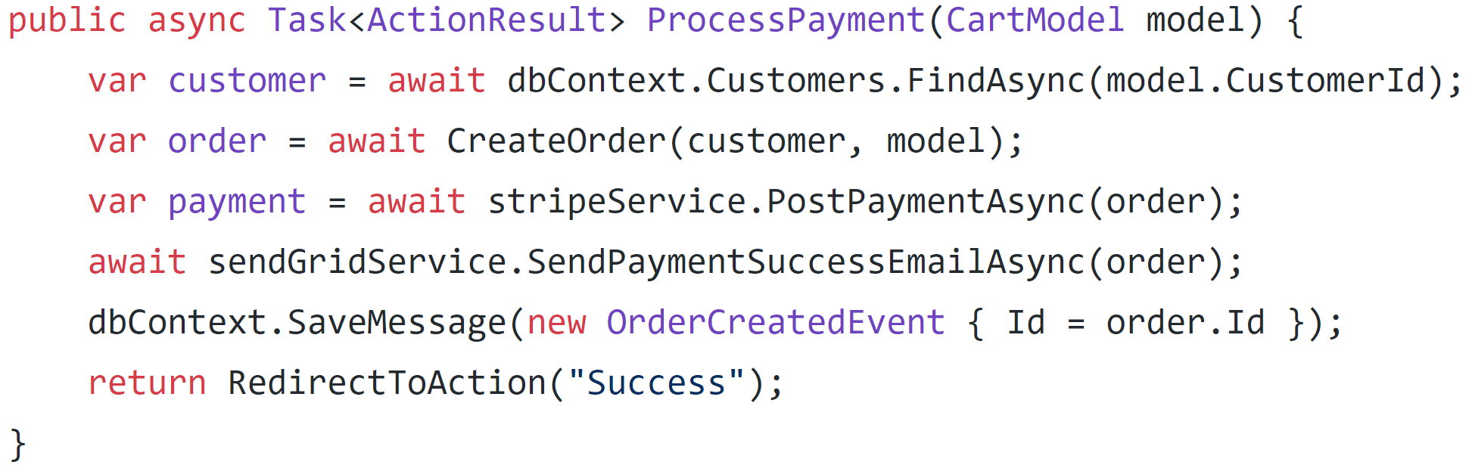
Outbox pattern

Slide 90
Outbox pattern

Slide 91
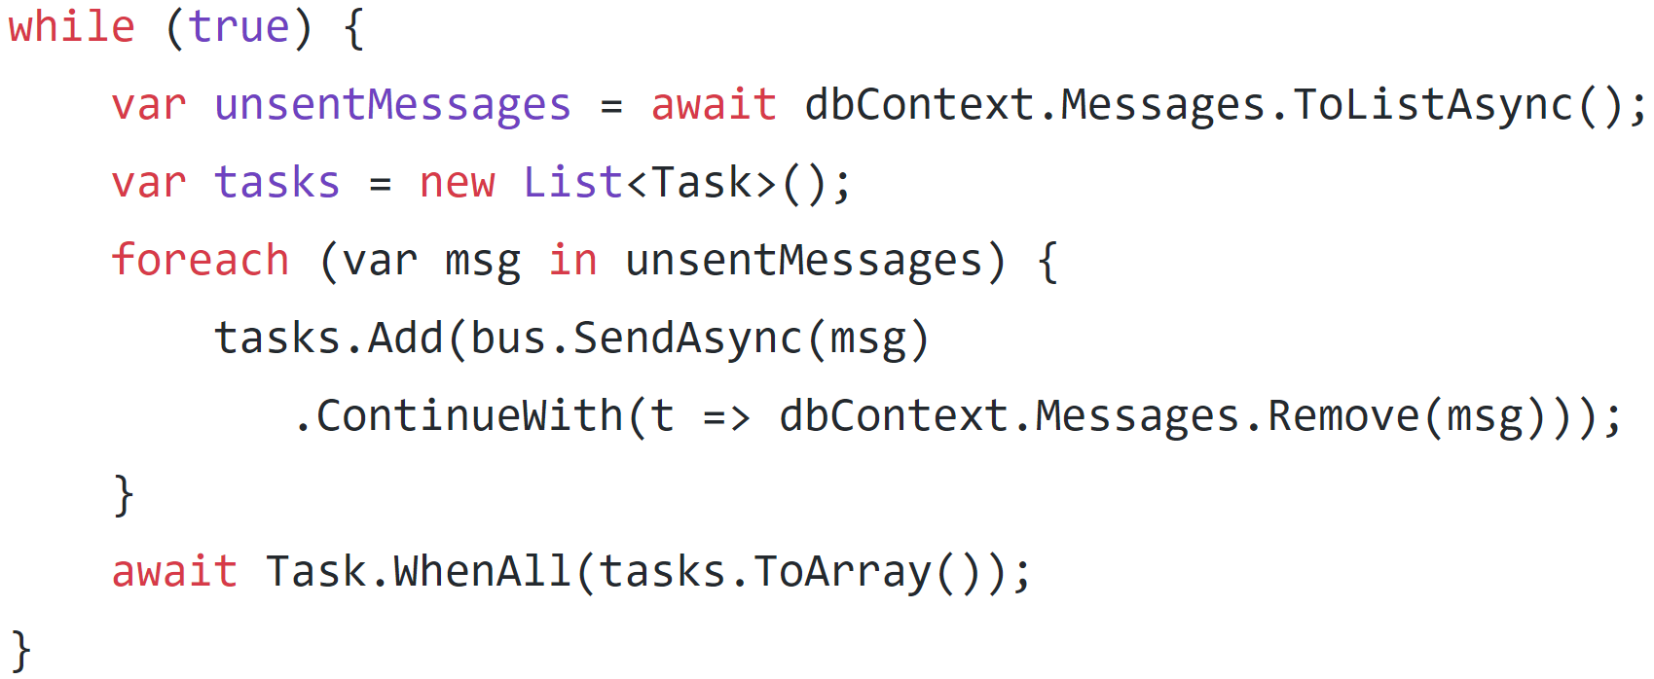
Outbox pattern

Slide 92
Still not there…

Slide 93
Way too much going on in a single button click

Slide 94
Workflow Constraints
Stripe – minimize checkout fallout rate, process offline
Sendgrid – send offline
RabbitMQ – send offline

Slide 95
Starting the workflow

Slide 96
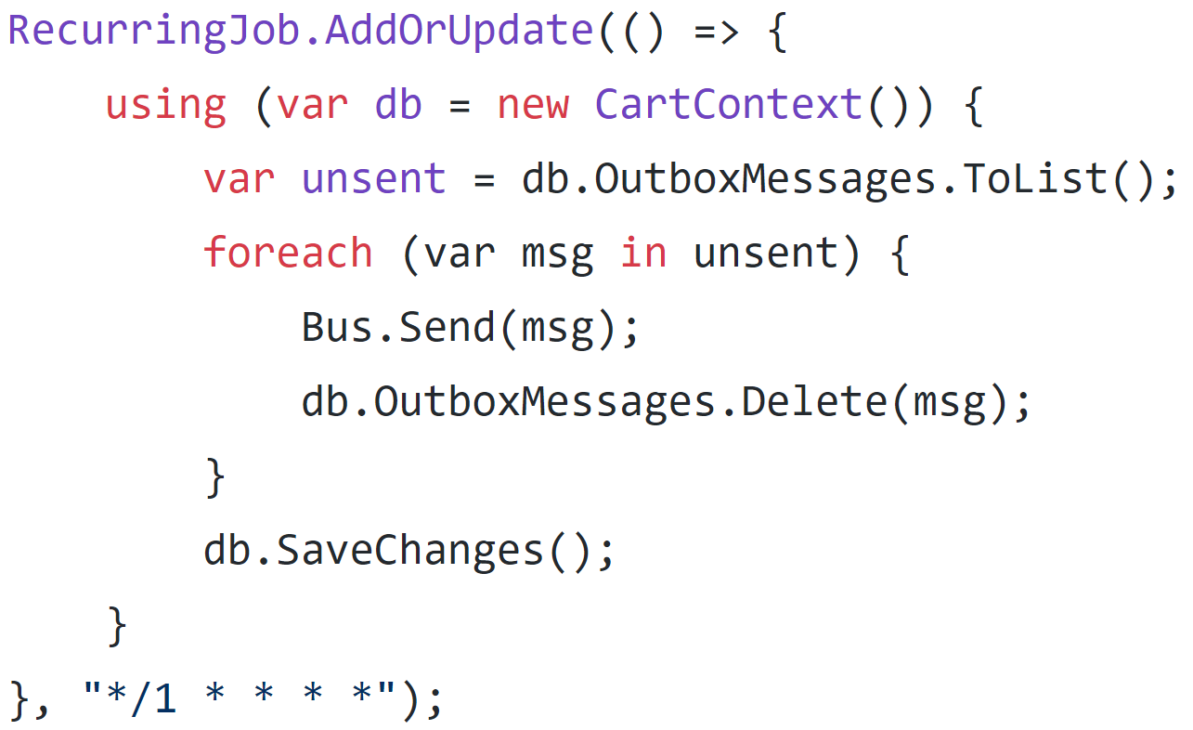
Scheduled jobs with Hangfire

Slide 97
API
Stripe
API
POST
Order Processor
SendGrid
???
DB
Task
RabbitMQ

Slide 98
Routing slip

Slide 99
API
Stripe
API
POST
SendGrid
DB
Task
RabbitMQ

Slide 100
API
Stripe
API
POST
SendGrid
DB
Task
RabbitMQ

Slide 101
Saga pattern

Slide 102
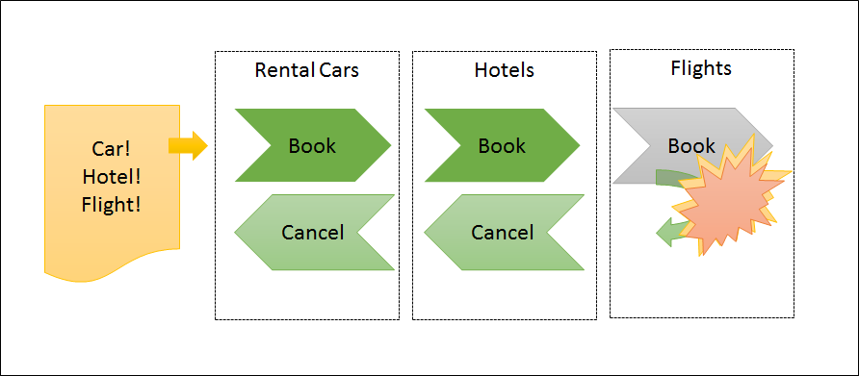

Slide 103
Process manager pattern

Slide 104
API
Stripe
API
POST
Process Manager
SendGrid
DB
Task
RabbitMQ

Slide 105
Orchestration or choreography?
Command-based or event-based?

Slide 106
Process coupling
Stripe – orchestration
Sendgrid – choreography
RabbitMQ - choreography

Slide 107
API
Stripe
API
POST
Process Manager
SendGrid
DB
Task
Service A
Service B

Slide 108
API
Stripe
API
POST
Process Manager
SendGrid
DB
Task
Service A
Service B

Slide 109
API
Stripe
API
POST
Process Manager
SendGrid
DB
Task
Service A
Service B

Slide 110
API
Stripe
API
POST
Process Manager
SendGrid
DB
Task
Service A
Service B

Slide 111
API
Stripe
API
POST
Process Manager
SendGrid
DB
Task
Service A
Service B

Slide 112
API
Stripe
API
POST
Process Manager
SendGrid
DB
Task
Service A
Service B

Slide 113
API
Stripe
API
POST
Process Manager
SendGrid
DB
Task
Service A
Service B

Slide 114
Code Example

Slide 115

Fixing Distributed Systems Fail
Jimmy Bogard
@jbogard
github.com/jbogard/presentations
jimmybogard.com

